Slide 1
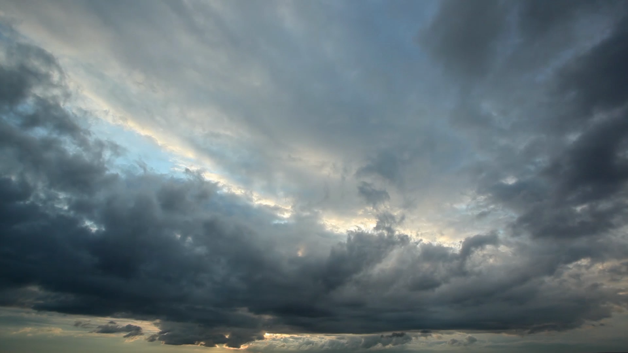
Water Consumption between apartments and dorms
Lan Pham, Kien Vu, Trang Dang

Slide 2
Introduction
Dickinson is famous for its sustainability program and its commitment to being carbon neutral
A lot of resources are being utilized in the most efficient way, i.e we have buildings that are ranked on its energy usage, campus food is grown at the farm and then the waste is turned into compost, etc.
Dickinson is ranked as Gold on STARS, a program that evaluates universities on its sustainability program. However, for water usage, Dickinson gains a score of 1.04/4, meaning that we have room for improvement in reducing potable water use per campus user.
In this report, we tried to study the water usage of students in their campus housing.
Our hypothesis is that there is a difference between the water usage of different class years. Understanding their behavior can better target our outreach efforts.

Slide 3
Objectives
Table 1: Average water billing by class year
We got water billing data from 2018 until 2020 by buildings
We also got data for the number of students who live in those buildings.
By calculating the average water bill per student, we can compare the average usage of water by class year using ANOVA.
Hypothesis:
H0: mean water usage of freshmen = sophomores = juniors = seniors
H1: There exists at least two of the class years who have unequal mean water usage.
 | FY | Soph. | Junior | Senior
S18 | 96.5 | 121.1 | 99.9 | 122.7
F18 | 106.7 | 125.2 | 121.6 | 109.5
S19 | 96.7 | 116.5 | 114.3 | 122.2
F19 | 133.7 | 124.0 | 132.2 | 145.3
S20 | 119.2 | 111.9 | 118.1 | 111.7
S: Spring; F: Fall

Slide 4
Sampling Method
Our desired observation is the mean water use for each class year in each semester.
The housing data only include building-wide use and number of residents by class year.
Therefore, we used the building average and weigh it by number of residents of that class year when adding up the semester figure.
By adding the sample semester total and average them, we account for variations in building type and non-class-year-specific factors.
However, using the building average for mixed-class year buildings might mean some bias, and so do class year-specific changes that affect water use.

Slide 5
Data Issues
We divide the data into semesters, since some of the buildings may be rented out during the summer
Problem 1: the water bill is charged every 2,3, or 4 months and the billing month is not identical among buildings
=> We got data from August, September, October, November, & December for semester 1 and Febuary, March, April for semester 2 and get the monthly average (adjusted for holidays).
Problem 2: apart from dorms that are specified for freshmen and apartments for seniors, other buildings have students from mixed school year. There are also differences in housing types
=> We determined the portion of each class year within each housing assignment and weigh it when adding to the semester total. However, we cannot account for difference within each building.
Problem 3: the process of data collecting seems to be faulty. For example, in 2019, Goodyear has a total water bill for 3 months accounted to 515$ while having 117 students living there.
=> We tried to eliminate them if they are too obvious of an outlier, but some are consistent over the years which might suggest unique building characteristics.

Slide 6
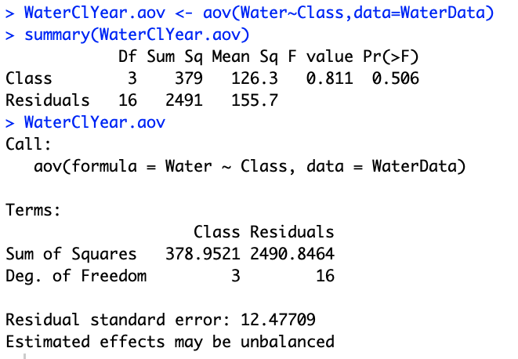
Results
Table 2: ANOVA Results
H0: mean water usage of freshmen = sophomores = juniors = seniors
H1: There exists at least two of the class years who have unequal mean water usage.
Conclusion: P-value is large; thus we cannot reject the null hypothesis and there is little evidence to suggest a difference in water usage between class years.

Slide 7
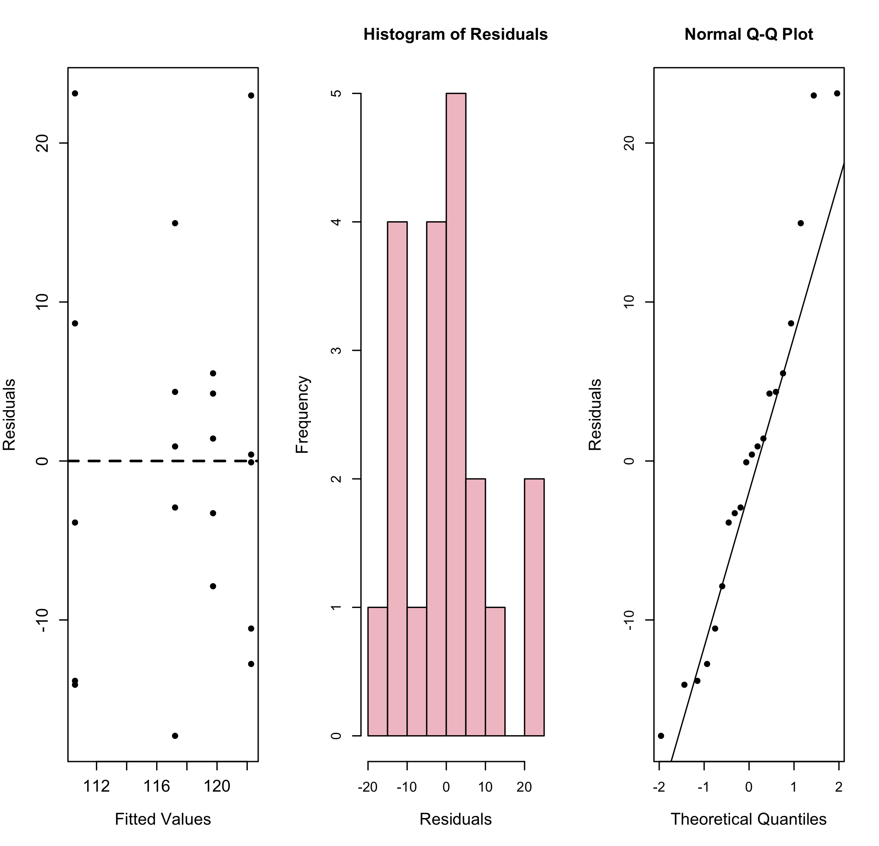
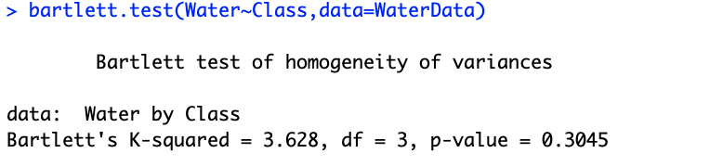
Checking the Assumptions
Table 3: Residual plots
The Q-Q Plot and the residuals histogram may suggest a normal distribution of variances.
From the Residuals against fitted values and the Bartlett's test results, we can keep the equal variances assumption.
Table 4: Bartlett's test result

Slide 8
Conclusion
All p-values are too big at 5% confidence interval; therefore, we do not reject the null hypothesis. There are little evidence to suggest differences between water usage among class years.
However, limitations of the methods include possible bias from mixed year housing during data collection. Generalization over time might be limited due to possible external factors during the data period.
Since the data has some possible errors such as misreporting or technical issues, we should be more careful at the data collection process.

